Slide 1
K-12 Learning Outcomes and Funding What are the learning outcomes for grades K-12, by states? What is the level of funding for K-12 schools, by states?

Slide 2
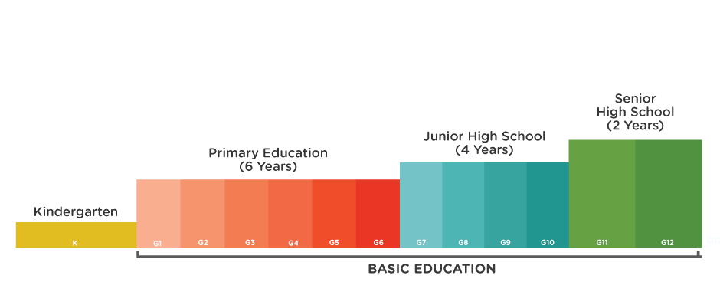
What is K-12 Education?
Short form for Kindergarten (K) and the 1st through 12th grade.
Used in United States, Canada and some other countries.

Slide 3
Learning outcomes of K-12

Slide 4
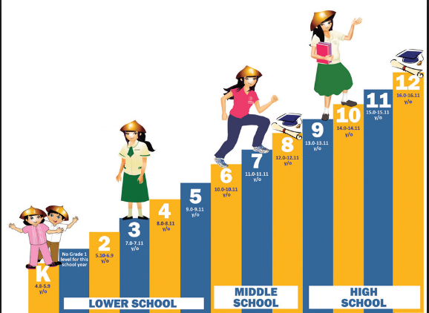
Learning outcomes of K-12
Following are the main expected outcomes of K-12 across different states of the United States:
Knowledge
Skills
Think
Performance
Understanding

Slide 5
Knowledge
To be able to know the content of
the curriculum
To be able to extract the desired
information from the curriculum
To be able to extract facts from
the information

Slide 6
Skills
To be able to apply the basic concepts
learned in the curriculum
To be able to process cognitive operations
To be able to constructs meaning from the
information and facts in the course
curriculum

Slide 7
Think
To be able to think analytically and logically
To be able to use creative techniques
To be able to solve problems based on
knowledge and experience
To be able to make decisions based on
knowledge and experience

Slide 8
Understanding
Understand the importance of work and finances
Understand the importance of future, career
and education
Understand how career, finance and
educational opportunities are affected by
performance

Slide 9
Performance
Application of Knowledge, Skills and
Understanding in Practical Life
Be able to perform real life tasks
Be able to perform real life decision
making and problem solving

Slide 10
K-12 Learning Outcomes Summary
K-12 education is expected to equip students with reading and writing as well thinking creatively and logically as a student progresses over to the upper grades. The ultimate expected outcome is to prepare the student to get into a college or a university to choose a practical field of education that can help the student pursue a successful career.

Slide 11
Level of Funding for K-12

Slide 12
Source of Funding
According to U.S. Constitution the responsibility for public K-12 education is with the states.
Federal funding has also increased over the time.
Federal funds are sent directly to states and local governments

Slide 13
State level funding
In year 2004-05 school year, states and local levels contributed 83% to K-12 education
45.6 percent from state funds
37.1 percent from local governments
Private sources 8.9 percent
Federal share was 8.3 percent

Slide 14
Federal Funding
Federal funds are sent directly to states and local governments
Federal fund is governed by different federal programs
In 2006, federal government provided funding in the following programs:
Title I: Provided $13 billion to local districts high poverty areas
Reading First: Provided over $1.1 billion to promote scientific means of reading
Improving teacher quality grants: $2.9 billion for teacher development and training.

Slide 15
Thank You!

