Slide 1
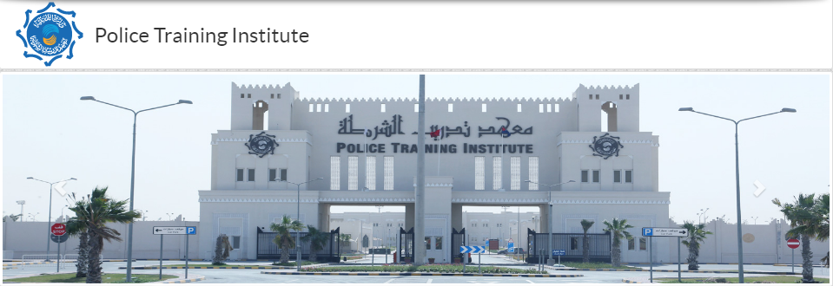
Graduation Police Training Institute in Qatar
By:

Slide 2
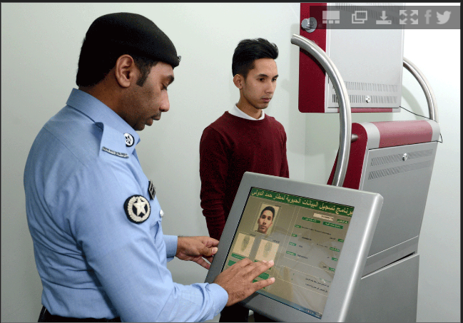
Introduction
Ministry of Interior responsible for
police training
Training play an essential role in developing
the police performance
Scientific tools utilized in police training
Police training course curriculum evolve
with time

Slide 3
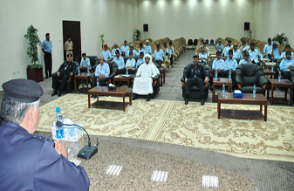
Different courses as part of the training
Officers Courses
Police Personnel Courses
Female Staff Courses
Computer Courses

Slide 4
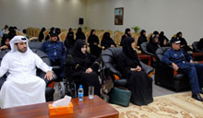
Different courses as part of the training Cont.
English Language Courses
Researches and Studies
Civil Servants Courses
Typical Security Department
Courses

Slide 5
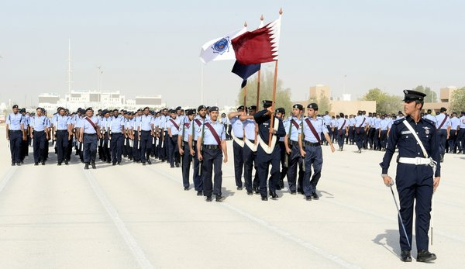
Training and Graduation ceremony
Police College Qatar,
Established 2013
4 Years Training and Course Work
Graduation ceremony held at
Police Academy Doha

Slide 6
Public Dealing by Qatar police
Police trained to communicate with both Qataris and foreigners
Police promote cooperation between public and police
Police ensures compliance with law by the public
You must report immediately to the police if you observe something illegal happening

Slide 7
Dealing with Qatar Police
Please avoid the following when dealing with Qatar Police:
Do not lose temper and get aggressive
Do not use bad language
Do not use a lot of hand gestures (culturally not looked at nice)

